Slide 1

Symbiosis Institute of Digital and Telecom Management
International Conference on Bio-Neuro Informatics and Algorithms(ICBNA 2022)
Title: Performance Analysis of Deep Learning models for
Detection of Pneumonia
Authors :
Karthik K N - Ramaiah Institute of Technology
K Divyasri - Ramaiah Institute of Technology
Dr. Sangeetha V - Ramaiah Institute of Technology

Slide 2
Contents
Abstract
Introduction
Literature Survey
Problem Definition
Proposed Work
Methodology & Implementation
Results & Discussions
Conclusion
References

Slide 3
Abstract
Pneumonia is an acute lung disease in which fluid fills the alveolar sacs, causing respiratory problems. Timely detection of pneumonia is the need of the hour.
Transfer learning is a deep learning strategy that employs pre-trained models, such as Visual Geometry Group (VGG16), Inception v3, Xception etc., to tackle new problems. These techniques necessitate a huge dataset, which makes processing time-consuming.
Hence, a Deep Convolutional Neural Network (Deep CNN) based architecture is being proposed.
The proposed model employs data augmentation, dropout regularization and various keras layers.
This makes the model computationally low, cost and time effective.

Slide 4
Introduction
Early detection of pneumonia requires careful analysis of chest x-rays, which requires the intelligence of highly competent and highly trained radiologists.
Compared to traditional Machine Learning models, the newest technology that uses Deep Learning models delivers a higher level of accuracy.
The primary motive is to experiment and find the optimal model for detecting pneumonia at a minimal computational cost.
A CNN-based model that is less computationally intensive is being proposed.
The key rationale would be to make it simple to deploy the model on an Android device and allow a regular citizen to verify if he or she has pneumonia by just uploading a chest X- ray image.

Slide 5
Literature Survey
Sl no | Title | Methodology | Results | Issues/Future work
[1] | Pneumonia Detection Using CNN based Feature Extraction. | A combination of pre-trained CNN based feature-extraction algorithms and supervised classifier algorithms were used. Hyper-parameter optimization in the classification was employed. Chest X-Ray image dataset from Kaggle was used. | Employing DenseNet-169 for the feature extraction stage and Support Vector Machines (SVM) for the classification stage resulted in the optimal value, 0.8002, of Area under the ROC Curve (AUC). | As the model exercises a lot of convolutional layers, the model need very high computational power.
[2] | Pneumonia detection using CNN | Keras Neural Network Library with Tensorflow backend has been used. Chest X-Ray image dataset from Kaggle(Train - 5216, Test-624, Validation-16). Data augmentation was applied. | 4 models with different number of Convolutional layers were trained. One Layer-89.74% accuracy Two Layers-85.26% accuracy Three Layers-92.31% accuracy Four Layers-91.67% accuracy Learning rate = 0.0001 | Neural network based on GAN(Generative Adversarial Networks), Transfer Learning Models can be trained to outperform CNN models. Larger datasets can be used.

Slide 6
[3] | Pneumonia Detection from Chest X-ray Images Based on Convolutional Neural Network | A VGG based model architecture with 6 layers including ReLU activation, drop operation, and max pooling layers. It was trained on the chest X-ray images from Kaggle. Dynamic Histogram Equalization technique was used to enhance the image contrast. | The proposed model performed better with an accuracy rate of 96.07% and precision rate of 94.41% as compared to various transfer learning models such as ResNet50, MobileNet, DenceNet121. | More accurate classification architectures to diagnose two types of pneumonia, viruses, and bacteria can be explored.
[4] | Transfer Learning Based Approach for Pneumonia Detection Using Customized VGG16 Deep Learning Model. | A modified VGG16 Deep Learning network is proposed. The output layers were then replaced by fully connected layers to learn on the dataset. The X-Ray scan dataset with 4273 scans of pneumonia class and 1583 scans of normal class was used. | The model was analysed for different optimizers such as Adam, Adagrad and Stochastic gradient descent (SGD). Accuracy using SGD = 74% Accuracy using Adagrad= 94.5% Accuracy using Adam = 98.5% | More advanced feature extraction methods based on several recently developed deep learning models for biomedical image segmentation could be used.

Slide 7
[5] | Feature Extraction and Classification of Chest X-Ray Images Using CNN to Detect Pneumonia | Two CNN architectures are used - one with a dropout layer and another without a dropout layer. Both CNN consist of convolution layer, max pooling and a classification layer. A series of convolution and max-pooling layers act as a feature extractor. The chest X-Ray images dataset from Kaggle was used. | Test accuracy of model 1 With Augmentation, With Dropout = 90.68% Test accuracy of model 2 With Augmentation, Without Dropout = 89.32% Test accuracy of model 3 Without Augmentation, With Dropout = 79.80% Test accuracy of model 4 Without Augmentation, Without Dropout = 74.98% | Early stopping and batch normalization can be used instead of dropout layer and their effect in avoiding overfitting can be analysed.

Slide 8
Problem Definition
To analyse and build a computationally low model with the use of Deep Learning algorithms and with minimal available data.

Slide 9
Proposed work
The various layers in the proposed Convolutional Neural Network(CNN) model are:
Convolutional layer: These layers act like filters for capturing features from the given input images. The proposed model consists of four Conv2D layers with 32, 64, 128 and 256 kernels (filters) with 3 x 3 dimension.
Max Pooling layer: These layers are used to down sample the image data. 2 x 2 MaxPooling2D layer that slides over the input image and stores the maximum intensity value of the current window.
Flatten layer: This layer is used to flatten the multi-dimensional input matrix to a one-dimensional vector so as to reduce the computational complexity of the pixel values.
Fully Connected/Dense layer: These consist of multiple layers which are totally linked to each other. There are two dense layers in the proposed model, first with 256 neurons and the second with 1 neuron. Each neuron extracts features and makes a prediction for classification of images.

Slide 10
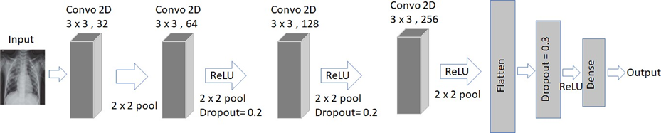
Activation function: The Rectified Linear Unit activation function is used in all of the convolutional layers and the first dense layer. The second dense layer employs the sigmoid activation function as the outputs are probability values between 0 and 1.
Optimizer: These are algorithms used to modify the weights, the learning rates of a neural network in order to reduce the loss during training. The Adam optimizer was employed with a learning rate of 0.001. Binary Cross Entropy is the loss function employed in the model.
Dropout layer: In order to avoid overfitting of the data, dropout regularisation was used. The second and third convolution layers were followed by a dropout of 20%. The fourth convolutional layer was followed by a dropout of 30%.
Fig. 1.

Slide 11
Methodology
The proposed model was trained on the chest X-Ray (Pneumonia) dataset available in Kaggle.
The dataset contains 5216 training, 624 testing, and 16 validation images in JPEG format with a 300 x 300 pixel size.
ImageDataGenerator class present in keras was used to perform data augmentation, in order to enlarge the dataset. This class randomly transforms the input images based on operations such as rotation, zoom, shift images horizontally and vertically, horizontal and vertical flip etc.
A Convolutional Neural Network(CNN) is used to analyse input X-Ray images and to infer output.
CNN is a feed forward network made up of numerous layers of neurons, each with the goal of lowering the dimensionality and complexity of the input image.
The proposed CNN model was developed using Keras library and Tensorflow backend.
The model was trained for 30 epochs and various performance parameters such as the train accuracy, test accuracy, precision, recall and F1 score were computed.

Slide 12
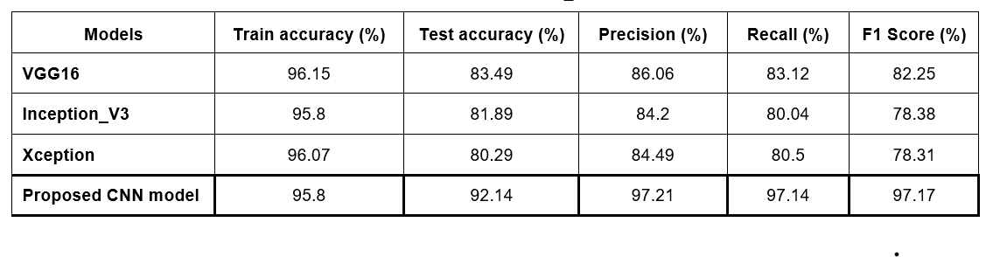
Results and Discussions
Increasing the amount of training data adds more information and improves model fit. As a result, employing a large dataset will result in increased training accuracy.
Though all the models in the below table have similar train accuracies, the proposed model has higher test accuracy when compared to the other transfer learning models.
This indicates that the proposed model works well with unseen images.

Slide 13
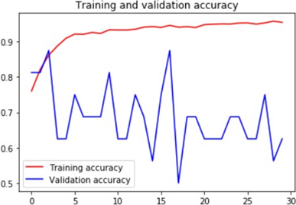
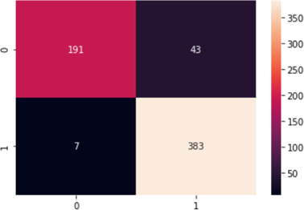
Fig.2. Indicates the plot of train and validation accuracy with respect to number of epochs.
Confusion matrix is used to define the proposed model’s performance as shown in Fig.3.
Fig.3. indicates lower TYPE1 and TYPE2 error, thus improved recall values are obtained.
Fig.2. Plot of accuracy VS number of epochs
Fig.3. The proposed model’s confusion matrix

Slide 14
Conclusion
Future work
In comparison to prior transfer learning models, the proposed deep convolutional network architecture, with data augmentation techniques and a dropout layer, extracted features from the input X-Ray images and obtained greater accuracy on unseen images.
Decent precision, recall and F1 score is obtained.
The proposed model can easily be deployed into an application and with the availability of chest X-ray images, any individual can detect the presence of streptococcus pneumoniae without depending on a radiologist.
Large datasets could be utilised in the future to train the model and attain greater accuracy.
Early stopping and batch regularisation could be used instead of the dropout layers to avoid the model from overfitting.
The dataset can be trained on other neural network architectures such as Generative Adversarial Networks (GAN) and their performance can be measured.

Slide 15
References
[1] D. Varshni, K. Thakral, L. Agarwal, R. Nijhavan 및 A. Mittal,“Pneumonia Detection Using CNN-Based Feature Extraction”, IEEE International Conference on Electrical, Computer and Communication Technologies (ICECCT), 2019, p. 17, doi:10.1109/ICECCT.2019.8869364
[2] Kaushik, V. and Nayyar, Anand and Kataria, Gaurav and Jain, Rakhna. (2020). Pneumonia detection using Convolutional NeuralNetworks (CNN). Lecture notes on networks and systems. 471 483. 10.1007/9789811533693_36.
[3] Zhang D., Fuquan Ren, Yushuang Li, Na, L., Yue Ma. Pneumonia detection in chest X-ray images based on a convolutional neuralnetwork. Electronics 2021, 10, 1512. https://doi.org/10.3390/electronics10131512.
[4] Ranjan, Amit Kumar, Chandrashekhar Gupta, Rohit Misra,Rajiv. (2022). Transfer Learning Based Approach for Pneumonia Detection Using Customized VGG16 Deep Learning Model.10.1007/978-3-030-94507-7_2.
[5] H. Sharma, J. S. Jain, P. Bansal and S. Gupta;Feature Extraction and Classification of Chest X-Ray Images Using CNN for Pneumonia Detection; 10th International Conference on Cloud Computing, Data Science and Engineering, 2020 (Confluence), 2020, p. 227231, doi: 10.1109/Confluence47617.2020.90578
[6] Rudan I, Tomaskovic L, BoschiPinto C, Campbell H, WHO Reference Group on Child Health Epidemiology, “Global Case Rates of Clinical Pneumonia in Children &lt;5 Years of Age”, Bull World Health Organ. December 2004; 82(12): 895903. Epub 2005, January 5. PMCID: PMC2623105.
[7] Avni W, Greenspan H, Konen E, Sharon M, Goldberger J. &quot;X-ray classification and retrieval at organ and pathology level using patch-based visual words,&quot; IEEE Trans. honey. Imaging, 30(3), pp. 733–746, 2011.

Slide 16
[8] Pattrapisetwong and V. Chiracharit, &quot;Automated Lung Segmentation of Chest X-Ray Using Shadow Filters and Multi-Step Thresholds,&quot; ICSEC (International Conference on Computer Science and Engineering), IEEE, 2016, pp. 1–6.
[9] Simonyan, K.; &amp; Zisserman, A. (2014). Very deep convolutional networks for large-scale image recognition. Preprinted arXiv arXiv: 1409.1556.
[10] Rajasenbagam T, Jeyanthi S, Pandian JA. Detection of pneumonia infection in lungs from chest X-ray images using deep convolutional neural network and content-based image retrieval techniques. J Ambient Intell Humaniz Comput. 2021 Mar 23:1-8.
[11] Mikolajczyk, A.; &amp; Grochowski, M. (2018). Data augmentation to improve deep learning in image classification problems. International Interdisciplinary Doctoral Seminar (IIPhDW). Swinoujscie, Poland, 117122.
[12] Frid-Adar, M.; Diamant, I.; Klang, E.; Amitai, M.; Goldberger, J.; and Greenspan, H. (2018). GAN-based synthetic medical image augmentation for increased CNN performance in liver lesion classification.
[14] Wigington, K.; Stewart, S.; Davis, B.; Barrett, B.; price, B.; &amp; Cohen, S. (2017). Data augmentation for handwritten word and string recognition using CNNLSTM networks. 14th IAPR International Conference on Document Analysis and Recognition (ICDAR). Kyoto, Japan, 639645.
[15] Shorten S., Khoshgoftaar T.M. Image data augmentation survey for deep learning. J Big Data 6, 60 (2019). https://doi.org/10.1186/s4053701901970.
[16] Arora P., Kapse VM, S. Sinha and S. Gera, “A Study on Pneumonia Detection and Analysis to Create Intelligent Systems Using Image Data Generators,” 9th edition on reliability, information and communication technology and optimization (trends and futures). International Conference, Direction 2021 ) (ICRITO), 2021, p. 14, doi: 10.1109/ICRITO51393.2021.9596434.

Slide 17
[17] Tang, H., Xu, D., Wang, W., Yang, Y., Sebe, N. (2019). Generating dual generator adversarial networks for multi-domain image-to-image transformations. In: Jawahar, K., Lee, H., Maury, G., Schindler, K. (eds.) Computer Vision - ACCV 2018. AKV 2018
[18] Ranjan, R.; Sankaranarayanan, S.; Castillo, CD; &amp; Chellappa, R. (2017). Allinone convolutional neural networks for face analysis. 12th IEEE International Conference on Automatic Face and Gesture Recognition (FG 2017). 1724 in Fairfield, USA.
[19] Y. Song, B. Xue, M. Zhang, and G. G. Yen, “Fully Automated Block-Based CNN Architecture Design”, IEEE Transactions on Neural Networks and Learning Systems, vol. 31, no. 4, pp. 1242 1254, April 2020, doi: 10.1109/TNNLS.2019.2919608.
[20] Y. Sunu, B. Xue, M. Zhang, G.G. Yen and J. Lv, &quot;AutomaticDesign of CNN Architectures Using Genetic Algorithms for Image Classification,&quot; IEEE Transactions on Cybernetics, vol. 50, no. September, 38403854, September 2020, doi: 10.1109 / TCYB.2020.2983860.
[21] Du,Y.(2015). Skeleton-based motion recognition using convolutional neural networks. 3rd IAPR Asian Pattern Recognition Conference (ACPR). Kuala Lumpur, Malaysia,579583.
[22] Singh, S. K., Thakur, R. K., Kumar, S., &amp; Anand, R. (2022,March). Deep Learning and Machine Learning based Facial Emotion Detection using CNN. In 2022 9th International Conference on Computing for Sustainable Global Development (INDIACom) (pp. 530-535). IEEE.
[23] Sindhwani, N., Verma, S., Bajaj, T., &amp; Anand, R. (2021). Comparative Analysis of Intelligent Driving and Safety Assistance Systems Using YOLO and SSD Model of Deep Learning.International Journal of Information System Modeling and Design (IJISMD), 12(1), 131-146.

Slide 18
Thank You

